Slide 1
Lesson 7: Binary Relations and their Properties
Topics to be covered.
Binary Relations
Reflexive Relations
Symmetric Relations
Anti-symmetric Relations
Transitive Relations
Combining Relations
n-ary Relations

Slide 2

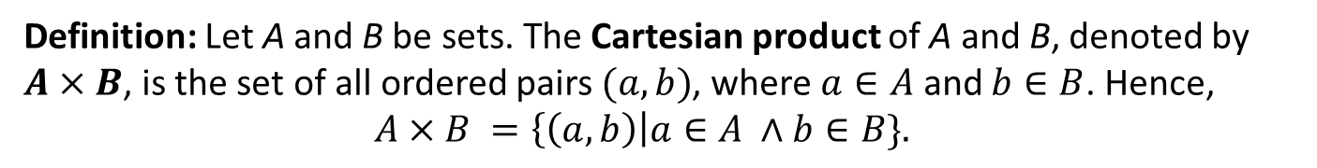
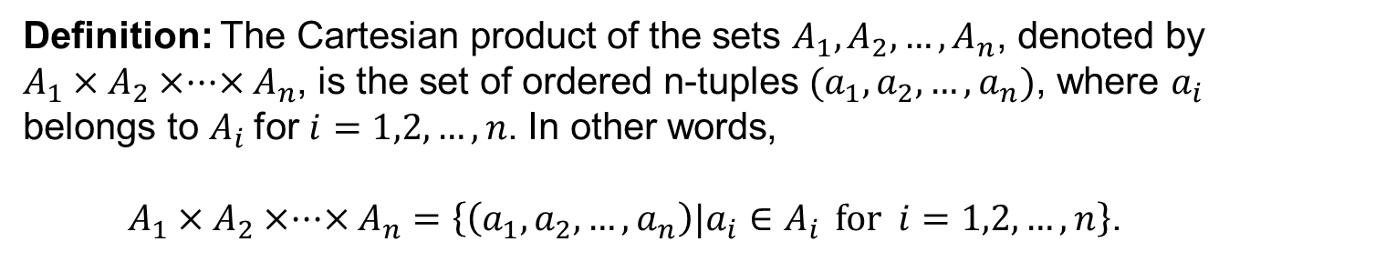
Cartesian product
Definition: Let A and B be sets. The Cartesian product of A and B, denoted by $A×B$, is the set of all ordered pairs $(a, b)$, where $a∈A$ and $b∈B$. Hence,
$$A×B =\left\{\left(a, b\right)\right|a∈A ∧b∈B\}.$$
Example: What is the Cartesian product of $A=\{ 1, 2\}$ and $B=\{a, b, c\}$?
$A×B=\left\{\left(1,a\right),\left(1,b\right),\left(1,c\right),\left(2,a\right),\left(2,b\right),\left(2,c\right)\right\}.$
Definition: The Cartesian product of the sets $A_{1},A_{2},…,A_{n}$, denoted by $A_{1}×A_{2}×···×A_{n}$, is the set of ordered n-tuples $(a_{1},a_{2},…,a_{n})$, where $a_{i}$ belongs to $A_{i}$for $i=1,2,…,n$. In other words,
$A_{1}×A_{2}×···×A_{n}=\left\{\left(a_{1},a_{2},…,a_{n}\right)|a_{i}∈A_{i } \text{for} i=1,2,…,n\right\}$.

Slide 3
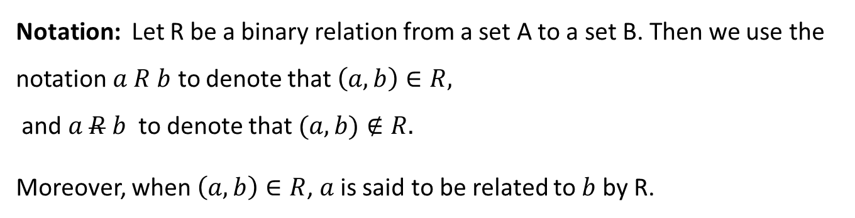
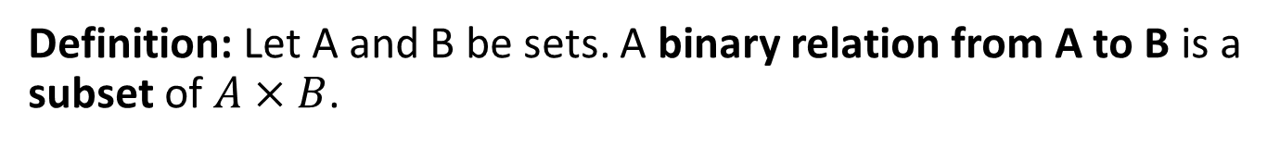
Binary Relations
Definition: Let A and B be sets. A binary relation from A to B is a subset of $A×B$.
In other words, a binary relation from A to B is a set R of ordered pairs where the first element of each ordered pair comes from A and the second element comes from B.
Notation: Let R be a binary relation from a set A to a set B. Then we use the notation $a R b$ to denote that $\left(a, b\right)∈R,$
and $a R b$ to denote that $(a,b)∉R.$
Moreover, when $\left(a, b\right)∈R$, $a$ is said to be related to $b$ by R.

Slide 4
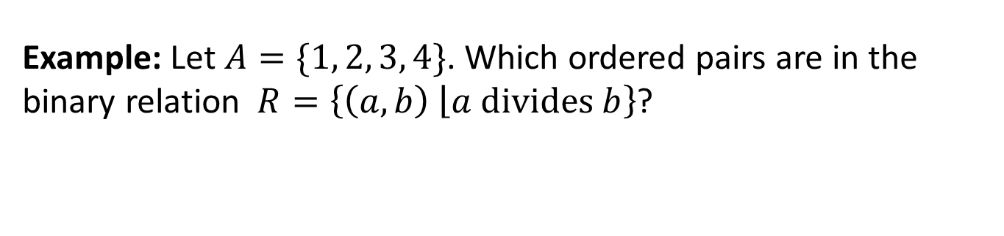
Binary Relations on a set
Definition: A binary relation on the set A is a relation from A to A.
Example: Let $A=\{1, 2, 3, 4\}$. Which ordered pairs are in the binary relation $R=\left\{\left(a, b\right) \left\lfloor a divides b\right.\right\}$?
$$R=\left\{\left(1,1\right), \left(1,2\right), \left(1,3\right), \left(1,4\right), \left(2,2\right), \left(2,4\right), \left(3,3\right), \left(4,4\right)\right\}.$$

Slide 5
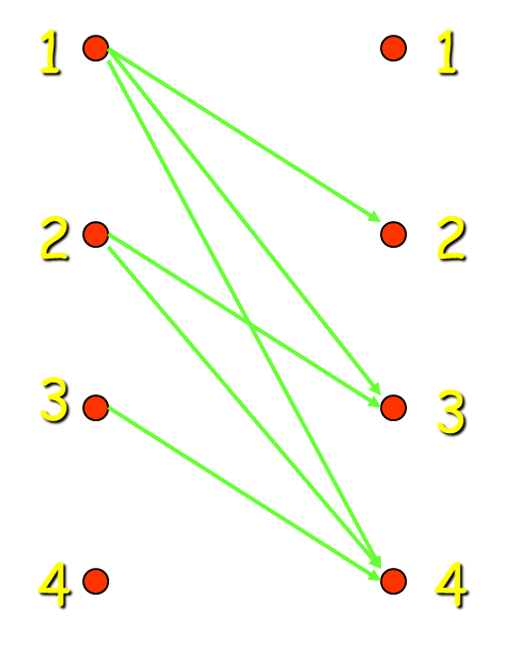
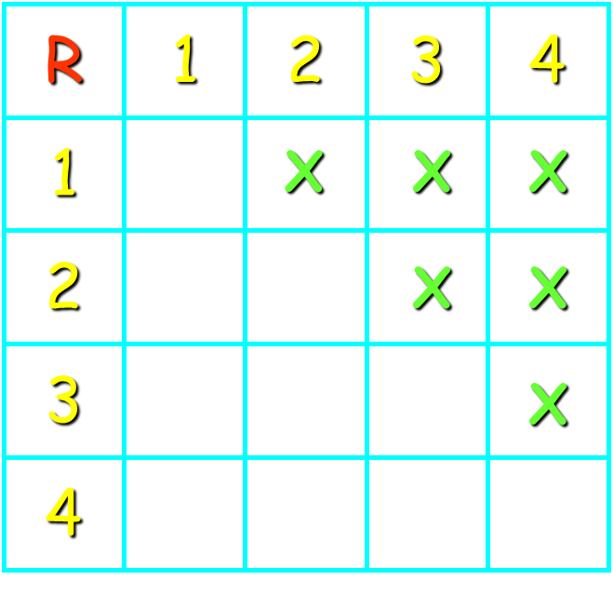

Example -1
Let $A = \{1, 2, 3, 4\}.$Which ordered pairs are in the binary relation on A given by $R = \{(a, b) | a < b\}$?
Solution: $R=\left\{\left(1,2\right), \left(1,3\right), \left(1,4\right), \left(2,3\right), \left(2,4\right), \left(3,4\right)\right\}.$

Slide 6


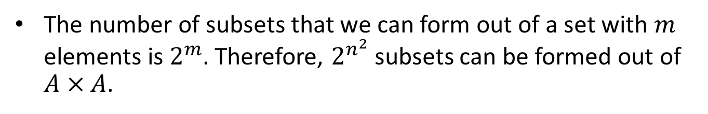
Relations on a Set
How many different relations can we define on a set A with n elements?
A relation on a set A is a subset of $A×A$.
How many elements are in $A×A$?
There are n² elements in $A×A$, so how many subsets (= relations on A) does $A×A$ have?
The number of subsets that we can form out of a set with $m$ elements is $2^{m}$. Therefore, $2^{n^{2}}$ subsets can be formed out of $A×A$.
Therefore, we can define $2^{n^{2}}$ different relations on A.

Slide 7
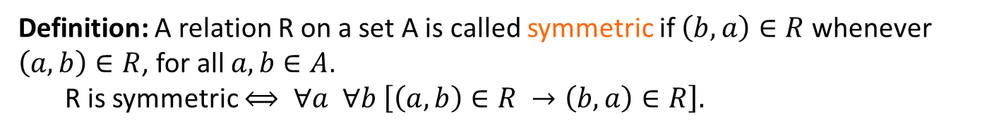
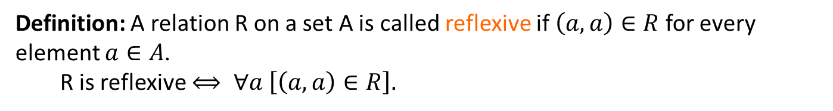
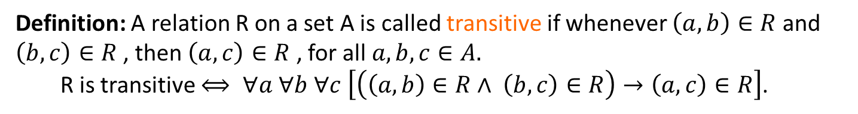
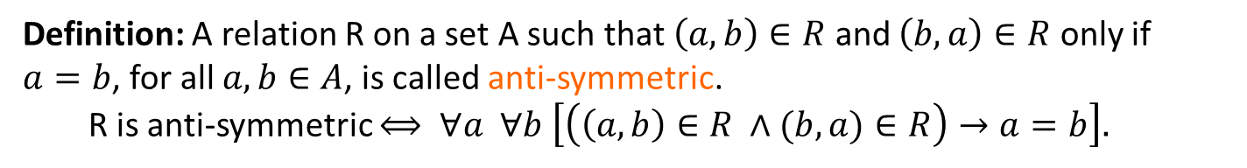
Properties of Relations
Definition: A relation R on a set A is called reflexive if $\left(a, a\right)∈R$ for every element $a∈A$.
R is reflexive $⟺ ∀a \left[\left(a,a\right)∈R\right].$
Definition: A relation R on a set A is called symmetric if $\left(b, a\right)∈R$ whenever $\left(a, b\right)∈R$, for all $a,b∈A$.
R is symmetric $⟺ ∀a ∀b \left[\left(a,b\right)∈R →\left(b,a\right)∈R\right].$
Definition: A relation R on a set A such that $\left(a, b\right)∈R$ and $\left(b, a\right)∈R$ only if $a=b$, for all $a,b∈A$, is called anti-symmetric.
R is anti-symmetric $⟺ ∀a ∀b \left[\left(\left(a,b\right)∈R ∧(b,a)∈R\right)→a=b\right].$
Definition: A relation R on a set A is called transitive if whenever $\left(a, b\right)∈R$ and $\left(b, c\right)∈R$ , then $\left(a, c\right)∈R$ , for all $a,b,c∈A.$
R is transitive $⟺ ∀a ∀b ∀c \left[\left(\left(a,b\right)∈R∧ \left(b,c\right)∈R\right)→\left(a,c\right)∈R\right]$.

Slide 8

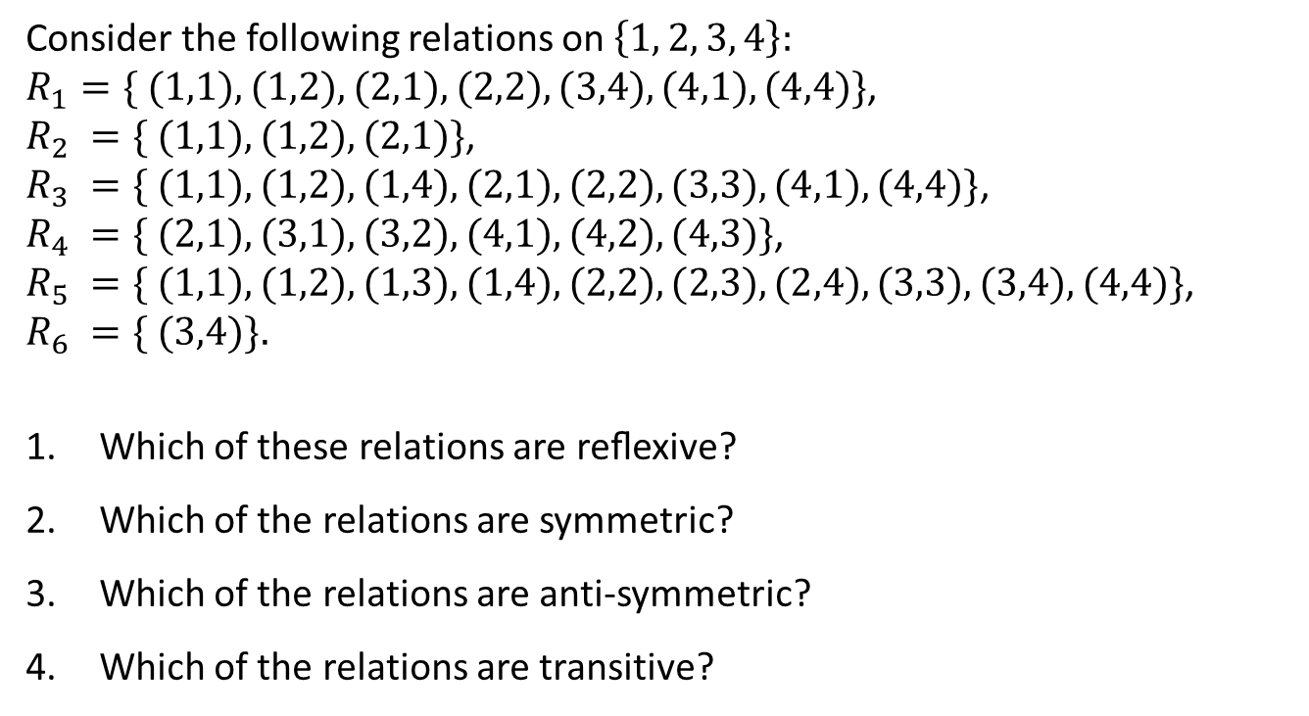



Example -2
Consider the following relations on $\left\{1, 2, 3, 4\right\}:$
$R_{1}=\{ (1,1),(1,2),(2,1),(2,2),(3,4),(4,1),(4,4)\}$,
$R_{2} =\{ (1,1),(1,2),(2,1)\}$,
$R_{3} =\{ (1,1),(1,2),(1,4),(2,1),(2,2),(3,3),(4,1),(4,4)\}$,
$R_{4} =\{ (2,1),(3,1),(3,2),(4,1),(4,2),(4,3)\}$,
$R_{5} =\{ (1,1),(1,2),(1,3),(1,4),(2,2),(2,3),(2,4),(3,3),(3,4),(4,4)\}$,
$$R_{6} =\{ (3,4)\}.$$
Which of these relations are reﬂexive?
Which of the relations are symmetric?
Which of the relations are anti-symmetric?
Which of the relations are transitive?
$$R_{3}, and R_{5}$$
$$R_{2}, and R_{3}$$
$$R_{4}, R_{5} and R_{6}$$
$$R_{4}, R_{5} and R_{6}$$

Slide 9

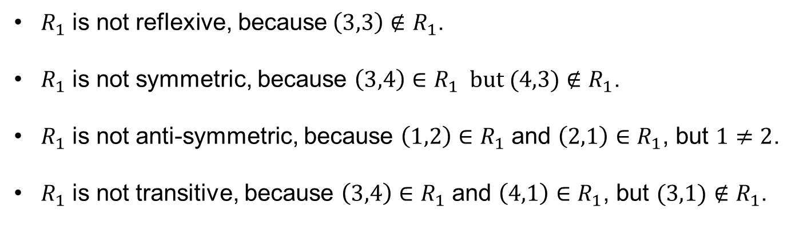
Solution to Example -2 ($R_{1}$)
Consider the relation $R_{1}$ on $\left\{1, 2, 3, 4\right\}$ given by
$R_{1}=\left\{ \left(1,1\right),\left(1,2\right),\left(2,1\right),\left(2,2\right),\left(3,4\right),\left(4,1\right),\left(4,4\right)\right\}.$
$R_{1}$ is not reflexive, because$\left(3,3\right)∉R_{1}$.
$R_{1}$ is not symmetric, because $\left(3,4\right)∈R_{1} but (4,3)∉R_{1}$.
$R_{1}$ is not anti-symmetric, because $\left(1,2\right)∈R_{1}$ and $\left(2,1\right)∈R_{1}$, but $1≠2$.
$R_{1}$ is not transitive, because $\left(3,4\right)∈R_{1}$ and $\left(4,1\right)∈R_{1}$, but $(3,1)∉R_{1}$.

Slide 10

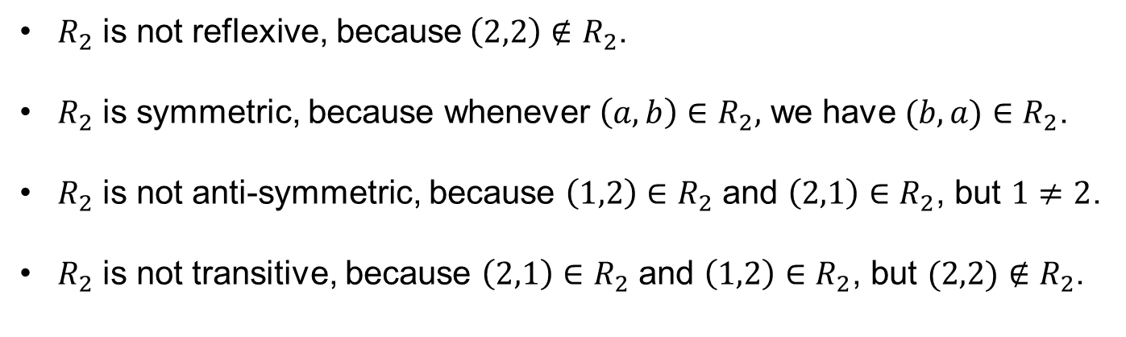
Solution to Example -2 ($R_{2}$)
Consider the relation $R_{2}$ on $\left\{1, 2, 3, 4\right\}$ given by
$R_{2}=\{ (1,1),(1,2),(2,1)\}.$
$R_{2}$ is not reflexive, because$\left(2,2\right)∉R_{2}$.
$R_{2}$ is symmetric, because whenever $\left(a,b\right)∈R_{2},$ we have $(b,a)∈R_{2}$.
$R_{2}$ is not anti-symmetric, because $\left(1,2\right)∈R_{2}$ and $\left(2,1\right)∈R_{2}$, but $1≠2$.
$R_{2}$ is not transitive, because $\left(2,1\right)∈R_{2}$ and $\left(1,2\right)∈R_{2}$, but $(2,2)∉R_{2}$.

Slide 11
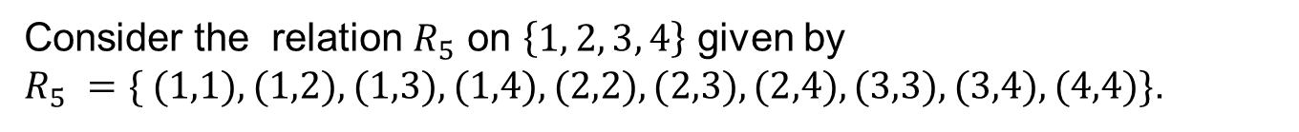

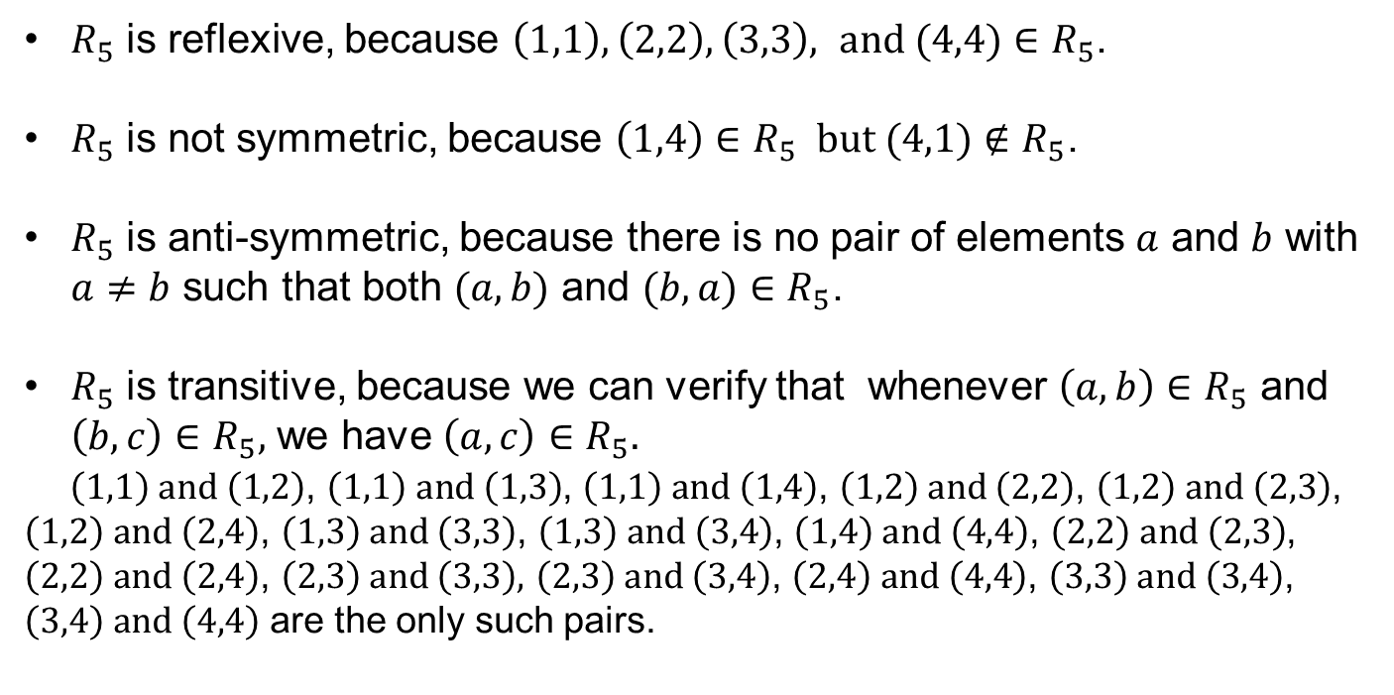
Solution to Example -2 ($R_{5})$
Consider the relation $R_{5}$ on $\left\{1, 2, 3, 4\right\}$ given by
$R_{5} =\{ (1,1),(1,2),(1,3),(1,4),(2,2),(2,3),(2,4),(3,3),(3,4),(4,4)\}$.
$R_{5}$ is reflexive, because $\left(1,1\right),\left(2,2\right),\left(3,3\right), and (4,4)∈R_{5}$.
$R_{5}$ is not symmetric, because $\left(1,4\right)∈R_{5} but (4,1)∉R_{5}$.
$R_{5}$ is anti-symmetric, because there is no pair of elements $a$ and $b$ with $a≠b$ such that both $(a, b)$ and $(b, a)∈R_{5}$.
$R_{5}$ is transitive, because we can verify that whenever $\left(a, b\right)∈R_{5}$ and $\left(b,c\right)∈R_{5},$ we have $\left(a,c\right)∈R_{5}.$
$\left(1,1\right) and \left(1,2\right)$, $\left(1,1\right) and \left(1,3\right)$, $\left(1,1\right) and \left(1,4\right)$, $\left(1,2\right) and \left(2,2\right)$, $\left(1,2\right) and \left(2,3\right)$, $\left(1,2\right) and \left(2,4\right)$, $\left(1,3\right) and \left(3,3\right)$, $\left(1,3\right) and \left(3,4\right)$, $\left(1,4\right) and \left(4,4\right)$, $\left(2,2\right) and \left(2,3\right)$, $\left(2,2\right) and \left(2,4\right)$, $\left(2,3\right) and \left(3,3\right),$ $\left(2,3\right) and \left(3,4\right)$, $\left(2,4\right) and \left(4,4\right)$, $\left(3,3\right) and \left(3,4\right)$, $\left(3,4\right) and \left(4,4\right)$ are the only such pairs.

Slide 12
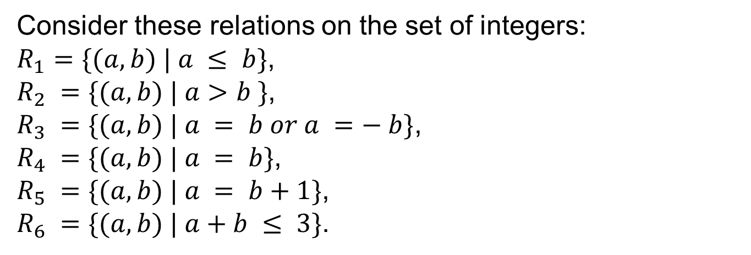
Example -3
Consider these relations on the set of integers:
$R_{1}=\{(a,b) | a ≤ b\}$,
$R_{2} =\{(a,b) | a>b \}$,
$R_{3} =\{(a,b) | a = b or a =− b\}$,
$R_{4} =\{(a,b) | a = b\}$,
$R_{5} =\{(a,b) | a = b+1\}$,
$R_{6} =\{(a,b) | a+b ≤ 3\}$.
Which of these relations are reﬂexive?
Which of the relations are symmetric?
Which of the relations are anti-symmetric?
Which of the relations are transitive?

Slide 13
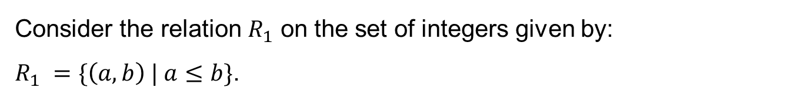

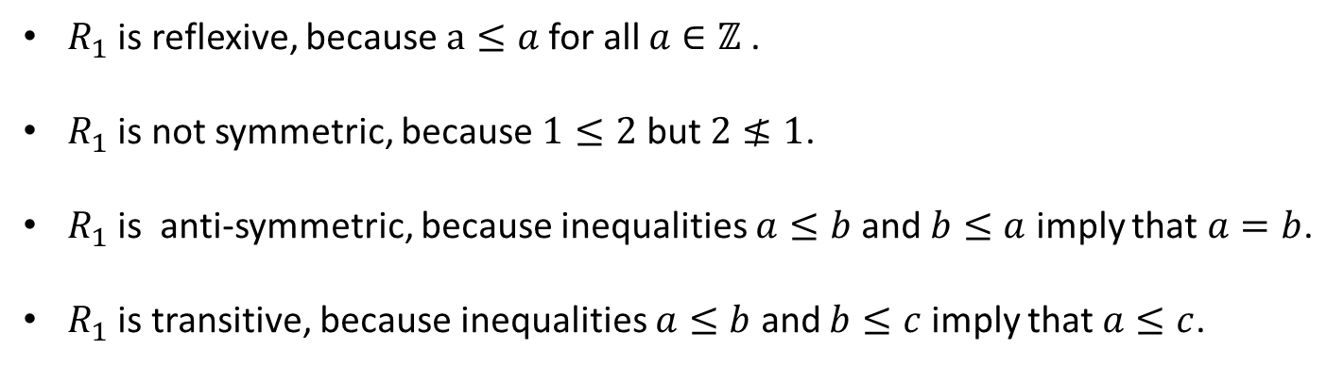
Solution to Example -3 ($R_{1}$)
Consider the relation $R_{1}$ on the set of integers given by:
$R_{1} =\{\left(a, b\right) | a≤b\}$.
$R_{1}$ is reflexive, because $a≤a$for all $a∈ℤ$ .
$R_{1}$ is not symmetric, because $1≤2$ but $2≰1$.
$R_{1}$ is anti-symmetric, because inequalities $a≤b$ and $b≤a$ imply that $a=b$.
$R_{1}$ is transitive, because inequalities $a≤b$ and $b≤c$ imply that $a≤c$.

Slide 14
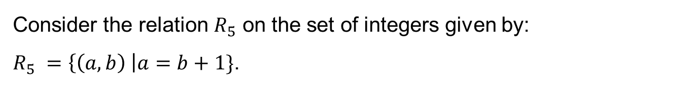

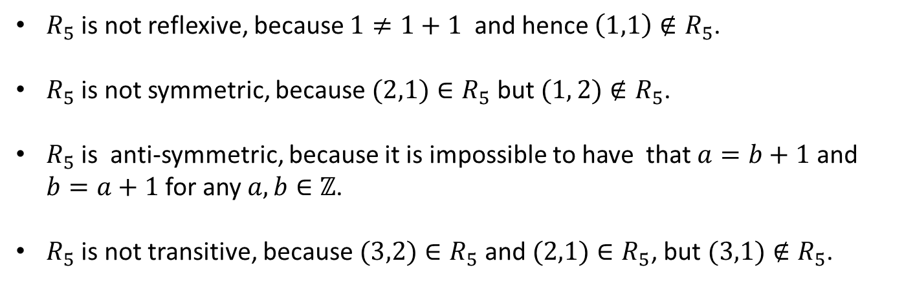
Solution to Example -3 ($R_{5}$)
Consider the relation $R_{5}$ on the set of integers given by:
$R_{5} =\left\{\left(a, b\right) \right|a=b+1\}$.
$R_{5}$ is not reflexive, because $1≠1+1$ and hence $\left(1,1\right)∉R_{5}$.
$R_{5}$ is not symmetric, because $(2,1)∈R_{5}$ but $(1, 2)∉R_{5}$.
$R_{5}$ is anti-symmetric, because it is impossible to have that $a=b+1$ and $b=a+1$ for any $a,b∈ℤ$.
$R_{5}$ is not transitive, because $(3,2)∈R_{5}$ and $(2,1)∈R_{5}$, but $(3,1)∉R_{5}$.

Slide 15
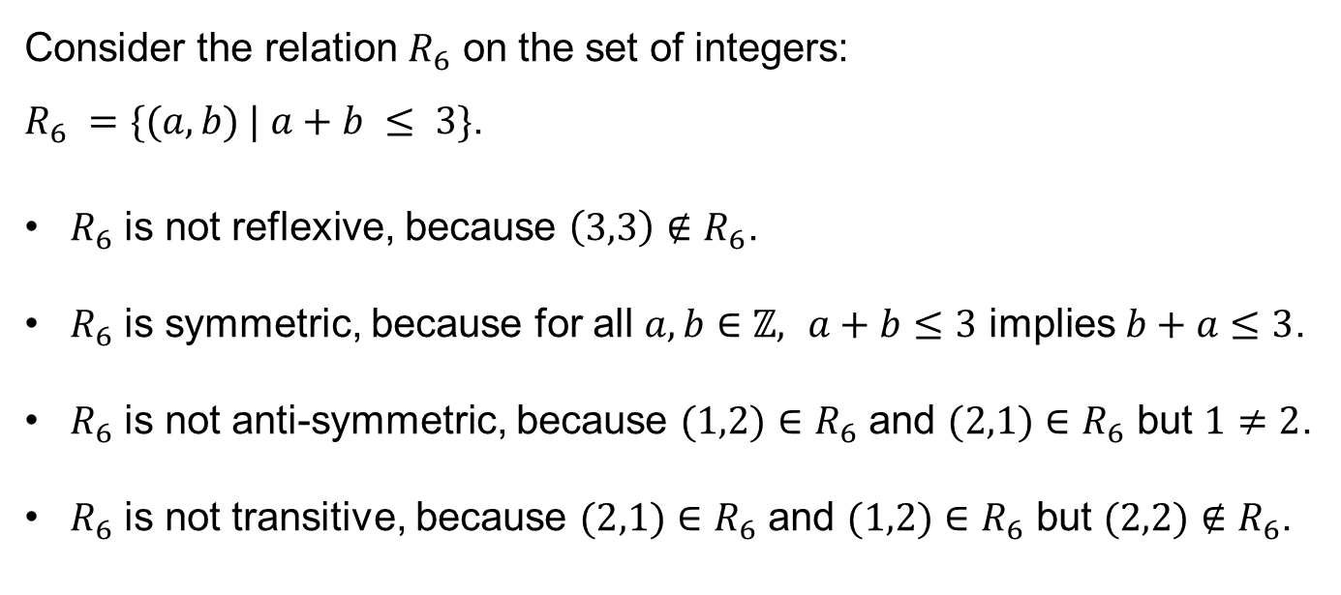

Solution to Example -3 ($R_{6}$)
Consider the relation $R_{6}$ on the set of integers:
$R_{6} =\{(a,b) | a+b ≤ 3\}$.
$R_{6}$ is not reflexive, because $\left(3,3\right)∉R_{6}$.
$R_{6}$ is symmetric, because for all $a,b∈ℤ,$ $a+b≤3$ implies $b+a≤3$.
$R_{6}$ is not anti-symmetric, because $(1,2)∈R_{6}$ and $(2,1)∈R_{6}$ but $1≠2$.
$R_{6}$ is not transitive, because $(2,1)∈R_{6}$ and $(1,2)∈R_{6}$ but $(2,2)∉R_{6}$.

Slide 16
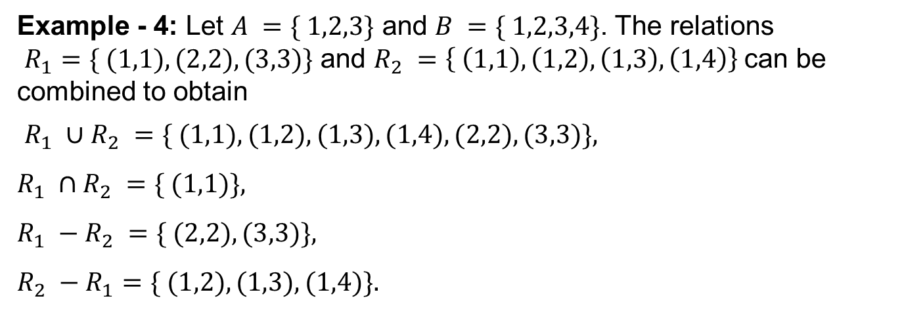
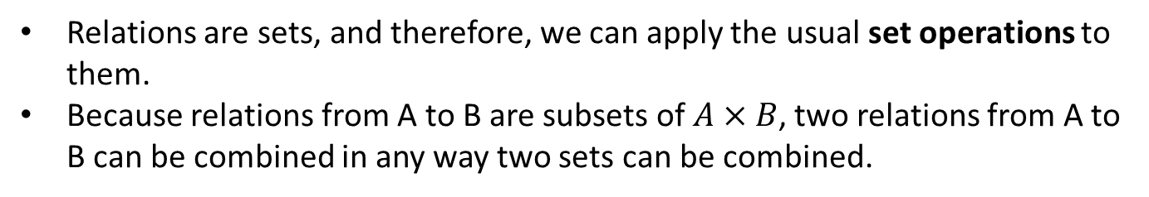
Combining Relations
Relations are sets, and therefore, we can apply the usual set operations to them.
Because relations from A to B are subsets of $A×B$, two relations from A to B can be combined in any way two sets can be combined.
Example - 4: Let $A =\{ 1,2,3\}$ and $B =\{ 1,2,3,4\}$. The relations
$R_{1}=\{ (1,1), (2,2), (3,3)\}$ and $R_{2} =\left\{ \left(1,1\right), \left(1,2\right), \left(1,3\right), \left(1,4\right)\right\}$can be combined to obtain
$R_{1} ∪R_{2} =\{ (1,1),(1,2),(1,3),(1,4),(2,2),(3,3)\},$
$$R_{1} ∩R_{2} =\{ (1,1)\},$$
$R_{1} −R_{2} =\{ (2,2),(3,3)\},$
$$R_{2} −R_{1}=\{ (1,2),(1,3),(1,4)\}.$$

Slide 17
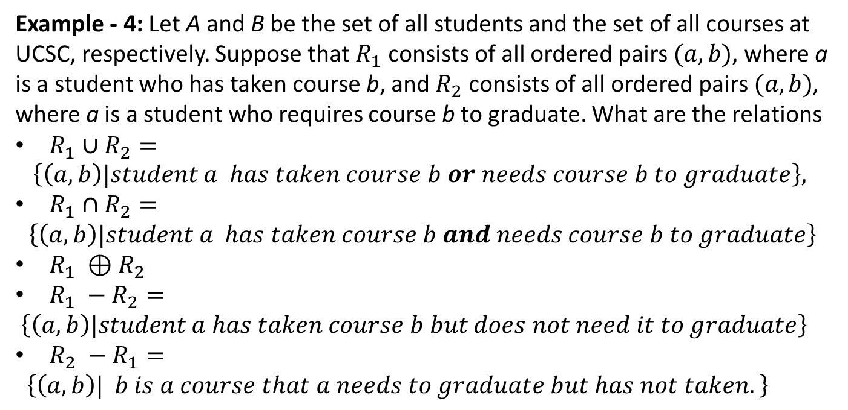
Combining Relations
Example - 4: Let A and B be the set of all students and the set of all courses at UCSC, respectively. Suppose that $R_{1}$ consists of all ordered pairs $(a,b)$, where a is a student who has taken course b, and $R_{2}$ consists of all ordered pairs $(a,b)$, where a is a student who requires course b to graduate. What are the relations
$R_{1}∪R_{2}=$
$$\left\{\left(a,b\right)|student a has taken course b or needs course b to graduate\right\},$$
$R_{1}∩R_{2}=$
$$\left\{\left(a,b\right)|student a has taken course b and needs course b to graduate\right\}$$
$R_{1} ⊕R_{2}$
$R_{1} −R_{2}=$
$\left\{\left(a,b\right)|student a has taken course b but does not need it to graduate\right\}$
$R_{2} −R_{1}=$
$\left\{\left(a,b\right)| b is a course that a needs to graduate but has not taken.\right\}$

Slide 18
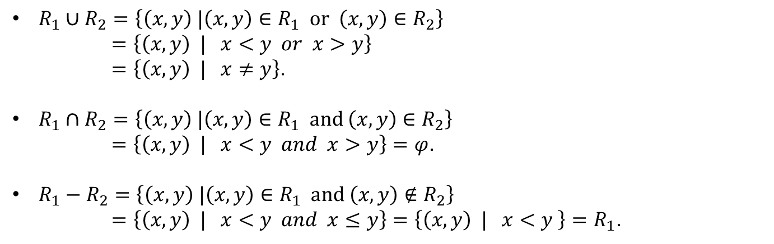
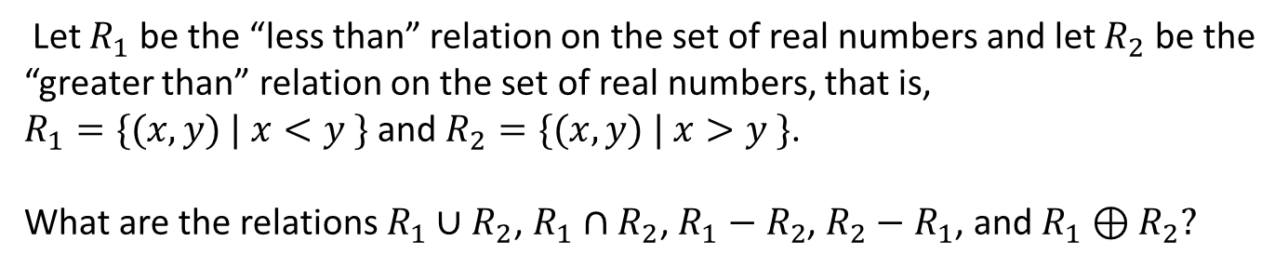
Example -5
Let $R_{1}$ be the “less than” relation on the set of real numbers and let $R_{2}$ be the “greater than” relation on the set of real numbers, that is, $R_{1}=\{(x,y) | x<y \}$and $R_{2}=\{(x,y) | x>y \}$.
What are the relations $R_{1}∪R_{2}$, $R_{1}∩R_{2}$, $R_{1}−R_{2}$, $R_{2}−R_{1}$, and $R_{1}⊕R_{2}?$
$R_{1}∪R_{2}=\left\{\left(x,y\right) |\left(x,y\right)∈R_{1} or \left(x,y\right)∈R_{2}\right\}$
$=\left\{\left(x,y\right) | x<y or x>y\right\}$
$=\left\{\left(x,y\right) | x≠y\right\}$.
$R_{1}∩R_{2}=\left\{\left(x,y\right) |\left(x,y\right)∈R_{1} and \left(x,y\right)∈R_{2}\right\}$
$=\left\{\left(x,y\right) | x<y and x>y\right\}=φ$.
$R_{1}−R_{2}=\left\{\left(x,y\right) |\left(x,y\right)∈R_{1} and \left(x,y\right)∉R_{2}\right\}$
$=\left\{\left(x,y\right) | x<y and x≤y\right\}=\left\{\left(x,y\right) | x<y \right\}=R_{1}$.

Slide 19
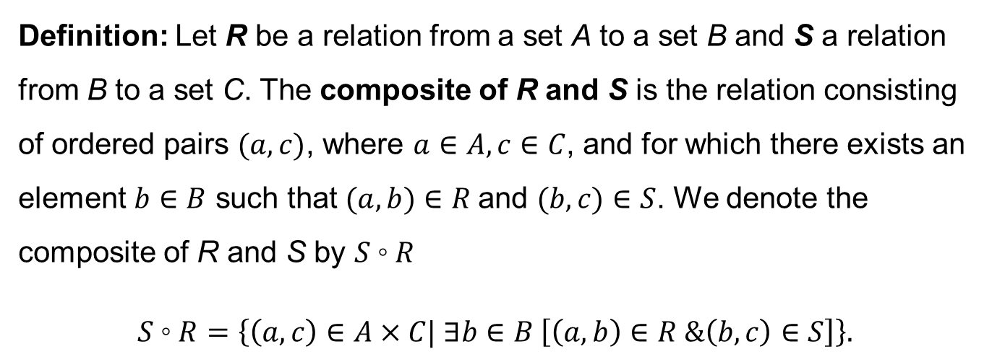
Combining Relations
Definition: Let R be a relation from a set A to a set B and S a relation from B to a set C. The composite of R and S is the relation consisting of ordered pairs $(a,c)$, where $a∈A, c∈C$, and for which there exists an element $b∈B$ such that $(a,b)∈R$and $(b,c)∈S$. We denote the composite of R and S by $S◦R$
$$S◦R=\left\{\left(a,c\right)∈A×C| ∃b∈B \left[\left(a,b\right)∈R \&\left(b,c\right)∈S\right]\right\}.$$

Slide 20
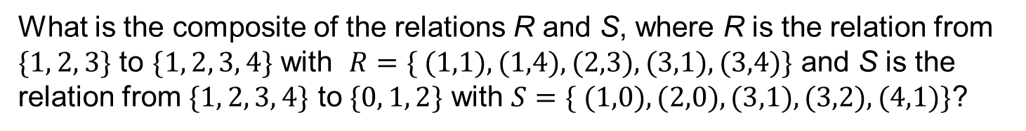



Example -6
What is the composite of the relations R and S, where R is the relation from $\{1, 2, 3\}$ to $\{1, 2, 3, 4\}$ with $R=\{ (1,1),(1,4),(2,3),(3,1),(3,4)\}$ and S is the relation from $\{1, 2, 3, 4\}$ to $\{0, 1, 2\}$ with $S=\{ (1,0),(2,0),(3,1),(3,2),(4,1)\}$?
1
1
0
1
0
2
2
1
2
1
3
3
2
3
2
4
$$R$$
$$S$$
$$S∘R$$
$$S◦R=\left\{\left(1,0\right), \left(1,1\right), \left(2,1\right), \left(2,2\right), \left(3,0\right), \left(3,1\right)\right\}.$$

Slide 21
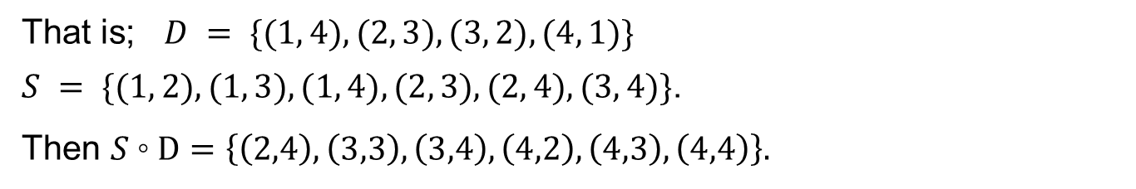
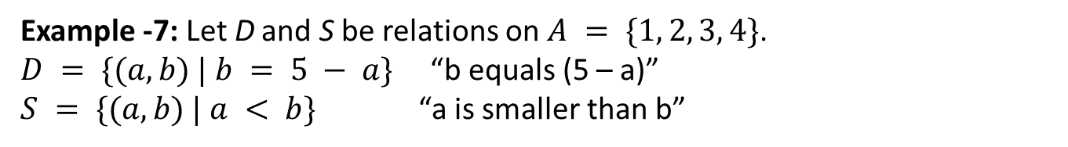
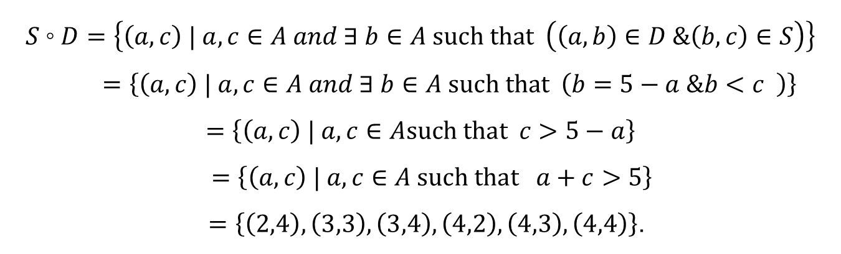
Combining Relations
Example -7: Let D and S be relations on $A = \{1, 2, 3, 4\}$.
$D = \{(a, b) | b = 5 − a\}$ “b equals (5 – a)”
$S = \{(a, b) | a < b\}$ “a is smaller than b”
That is; $D = \{(1, 4), (2, 3), (3, 2), (4, 1)\}$
$S = \{(1, 2), (1, 3), (1, 4), (2, 3), (2, 4), (3, 4)\}$.
Then $S◦D=\left\{\left(2,4\right), \left(3,3\right),\left(3,4\right),\left(4,2\right),\left(4,3\right),\left(4,4\right)\right\}.$
$$S◦D=\left\{\left(a,c\right) | a,c∈A and ∃ b∈A such that \left(\left(a,b\right)∈D \&\left(b,c\right)∈S\right)\right\}$$
$=\left\{\left(a,c\right) | a,c∈A and ∃ b∈A such that \left(b=5−a \&b<c \right)\right\}$
$$=\left\{\left(a,c\right) | a,c∈Asuch that c>5−a\right\}$$
$$=\left\{\left(a,c\right) | a,c∈A such that a+c>5\right\}$$
$=\left\{\left(2,4\right), \left(3,3\right),\left(3,4\right),\left(4,2\right),\left(4,3\right),\left(4,4\right)\right\}$.

Slide 22
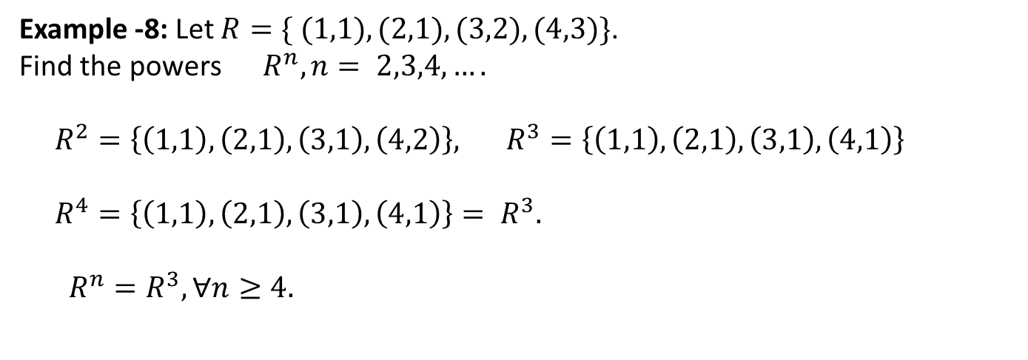
Powers of a Relation
The powers of a relation R can be recursively deﬁned from the deﬁnition of a composite of two relations.
Definition: Let R be a relation on the set A. The powers $R^{n},n= 1,2,3,…,$ are deﬁned recursively by $R^{1}=R$and $R^{n+1}= R^{n}◦R$.
The deﬁnition shows that $R^{2}=R◦R$, $R^{3}=R^{2}◦R=(R◦R)◦R$, and so on.
Example -8: Let $R=\{ (1,1),(2,1),(3,2),(4,3)\}$.
Find the powers $R^{n},n= 2,3,4,….$
$R^{2}=\left\{\left(1,1\right),\left(2,1\right),\left(3,1\right),\left(4,2\right)\right\},$ $R^{3}=\left\{\left(1,1\right),\left(2,1\right),\left(3,1\right),\left(4,1\right)\right\}$
$R^{4}=\left\{\left(1,1\right),\left(2,1\right),\left(3,1\right),\left(4,1\right)\right\}= R^{3}.$
$R^{n}=R^{3}, ∀n≥4.$

Slide 23
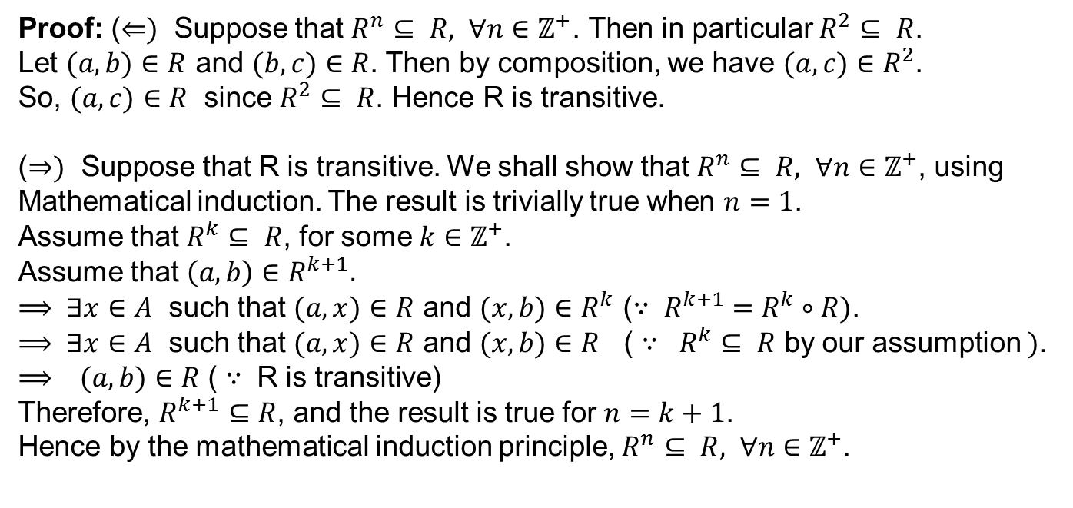
Application
Theorem: The relation R on a set A is transitive if and only if $R^{n}⊆ R, ∀n∈ℤ^{+}$.
Proof: ($⇐)$ Suppose that $R^{n}⊆ R, ∀n∈ℤ^{+}$. Then in particular $R^{2}⊆ R$.
Let $(a,b)∈R$ and $(b,c)∈R$. Then by composition, we have $(a,c)∈R^{2}$.
So, $(a,c)∈R$ since $R^{2}⊆ R$. Hence R is transitive.
($⇒)$ Suppose that R is transitive. We shall show that $R^{n}⊆ R, ∀n∈ℤ^{+}$, using Mathematical induction. The result is trivially true when $n=1$.
Assume that $R^{k}⊆ R$, for some $k∈ℤ^{+}$.
Assume that $\left(a, b\right)∈R^{k+1}.$
$⟹ ∃x∈A$ such that $(a,x)∈R$ and $(x,b)∈R^{k}$ (${∵ R}^{k+1} =R^{k}∘R)$.
$⟹ ∃x∈A$ such that $(a,x)∈R$ and $(x,b)∈R$ ( $∵ R^{k}⊆ R$ by our assumption $)$.
$⟹ (a,b)∈R$ ( $∵$ R is transitive)
Therefore, $R^{k+1}⊆R$, and the result is true for $n=k+1$.
Hence by the mathematical induction principle, $R^{n}⊆ R, ∀n∈ℤ^{+}$.

Slide 24
Functions as Relations
You might remember that a function f from a set A to a set B assigns a unique element of B to each element of A.
The graph of f is the set of ordered pairs $(a, b)$such that $b=f(a)$.
Since the graph of f is a subset of $A×B$, it is a relation from A to B.
Moreover, for each element a of A, there is exactly one ordered pair in the graph that has a as its first element.
Conversely, if R is a relation from A to B such that every element in A is the first element of exactly one ordered pair of R, then a function can be defined with R as its graph.

Slide 25
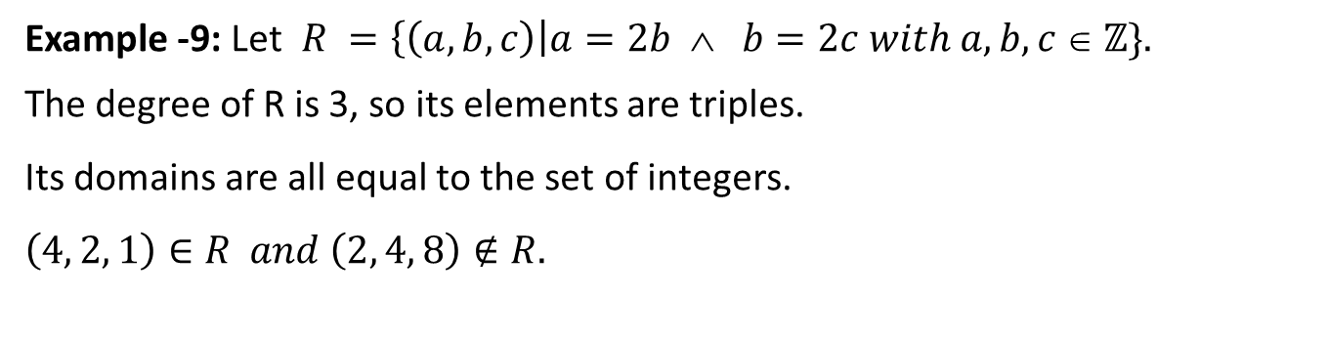
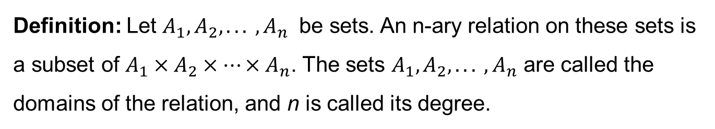
n - ary Relations
We begin with the basic deﬁnition on which the theory of relational databases rests.
Definition: Let $A_{1}, A_{2}, . . . , A_{n}$ be sets. An n-ary relation on these sets is a subset of $A_{1}×A_{2}×⋯×A_{n}$. The sets $A_{1}, A_{2}, . . . , A_{n}$ are called the domains of the relation, and n is called its degree.
Example -9: Let $R =\left\{\left(a, b, c\right)\right|a=2b ∧ b=2c with a, b, c ∈ ℤ\}.$
The degree of R is 3, so its elements are triples.
Its domains are all equal to the set of integers.
$$\left(4, 2, 1\right)∈R and \left(2, 4, 8\right)∉R.$$

